Slide 1
C to RTL GUI General Guidelines
Some frames are dockable
All italics are words shown in the GUI
Non-italics are comments/explanations (not in GUI)
General GUI architecture can be Tabs or Pull-Down Menu, whatever makes sense
After every “Compile”, all CDFG images have to be updated.
After every “Synthesis”, all RTL relevant data have to be updated.

Slide 2
Design Setup/Configuration
File/Directory Selection
C Source Code
C TestBench
LLVM Build Path
InLine Data Entries
Testbench Arguments
Top Level Function
Primary Clock Frequency (MHz)
Area (um2)
Power (mW)
Latency (#cycles)
Throughtput (#cycles)
Max. of Cycles
Other relevant clocks for inputs – allow users to add as many clocks as possible
Clock1 Frequency (MHz)
Clockn Frequency (MHz)
Options/Buttton
Processor Accelerator (default non-selected)
Browser
Browser
Browser
string
string
float
float
float
integer
integer
integer
+
float
+
float
Compile

Slide 3
Cross Correlation
CDFG is generated after “Compile”
RTL is generated after “Synthesis”
Xref is generated automatically
C Source
CDFG
RTL
345 if(quant_trunc_enable && ABS_INT(c0) < quant_trunc_threshold && zz0 > quant_trunc_idx)
346 t0 = 0;
347 else {
348 if(ctr == 0)
349 t0 = dc_clip(right_shift_int((int)c0 * (*(quant_factor + 0))));
350 else
351 t0 = ac_clip(right_shift_int((int)c0 * (*(quant_factor + 0))));
352 if (t0 && (zz0 > Last_NZ_Ind)) Last_NZ_Ind = zz0;
353 }
354
355 if(quant_trunc_enable && ABS_INT(c1) < quant_trunc_threshold && zz1 > quant_trunc_idx)
356 t1 = 0;
357 else {
358 t1 = ac_clip(right_shift_int((int)c1 * (*(quant_factor + 1))));
359 if (t1 && (zz1 > Last_NZ_Ind)) Last_NZ_Ind = zz1;
360 }
361
362
363 if(quant_trunc_enable && ABS_INT(c2) < quant_trunc_threshold && zz2 > quant_trunc_idx)
2329 a2c_addsub(_lvar_add_i_i, _lvar_add25_i_i, _lvar_add29_i_i, _constp_1b0_148_8, _constp_1b1_148_8, _uniquify_tco_148_8, _uniquify_tov_148_8#
2330 a2c_addsub(_lvar_add13_i_i, _lvar_add19_i_i, _lvar_add30_i_i, _constp_1b0_149_8, _constp_1b1_149_8, _uniquify_tco_149_8, _uniquify_tov_149#
2331 a2c_addsub(_lvar_add_i_i, _lvar_add25_i_i, _lvar_sub31_i_i, _constp_1b0_x1_79_10, _constp_1b0_x2_79_10, _uniquify_tco_79_10, _uniquify_tov#
2332 a2c_addsub(_lvar_add13_i_i, _lvar_add19_i_i, _lvar_sub32_i_i, _constp_1b0_x1_80_10, _constp_1b0_x2_80_10, _uniquify_tco_80_10, _uniquify_t#
2333 a2c_addsub(_lvar_sub_i_i, _lvar_sub28_i_i, _lvar_add35_i_i, _constp_1b0_152_8, _constp_1b1_152_8, _uniquify_tco_152_8, _uniquify_tov_152_8#
2334 a2c_addsub(_lvar_sub16_i_i, _lvar_sub22_i_i, _lvar_add36_i_i, _constp_1b0_153_8, _constp_1b1_153_8, _uniquify_tco_153_8, _uniquify_tov_153#
2335 a2c_addsub(_lvar_sub16_i_i, _lvar_sub28_i_i, _lvar_add37_i_i, _constp_1b0_154_8, _constp_1b1_154_8, _uniquify_tco_154_8, _uniquify_tov_154
23607 addsub_32_32_32 a2c_addsub_32_32_32_10127 (
23608 .CI (1'b0),
23609 .CO (),
23610 .DST (snet_1708),
23611 .MODE (1'b1),
23612 .OV (),
23613 .SRC1 (snet_83),
23614 .SRC2 (snet_84)
23615 );
23616
23617 addsub_32_32_32 a2c_addsub_32_32_32_10128 (
23618 .CI (1'b0),
23619 .CO (),
23620 .DST (snet_2209),
23621 .MODE (1'b0),
23622 .OV (),
23623 .SRC1 (snet_84),
23624 .SRC2 (snet_83)
23625 );
23626
23627 addsub_32_32_32 a2c_addsub_32_32_32_10129 (
23628 .CI (1'b0),
23629 .CO (),
23630 .DST (snet_4521),
23631 .MODE (1'b1),
23632 .OV (),
23633 .SRC1 (snet_44),
23634 .SRC2 (snet_1490)
23635 );
OPEN
OPEN
OPEN
Xref OPEN

Slide 4
Architecture Specifications
Architecture Specifications
General Options/Buttton
RTL Generation
Activity Tracking
General InLine Data Entries
Resource Constraints
Max. Number of Multipliers per cycle
Max. Number of Add/Subs per cycle
Max. Number of External Memory Read Port per cycle
Max. Number of External Memory Write Port per cycle
Max. Number of External Memory R/W Port per cycle
Loop Constraints
Loop0 SW pipelined Max Loop Iteration <int> Unroll by
Loopn SW pipelined Max Loop Iteration <int> Unroll by
integer
integer
integer
integer
integer
integer
integer
There is an API to find out how many loops after “Compile”. After Synthesis, you can query the max. loop iteration per loop. If the return value is -1, just put N/A there for <int>.

Slide 5
Architecture Specifications
Architecture Specifications
General Options/Buttton
RTL Generation
Activity Tracking
General InLine Data Entries
Resource Constraints
Max. Number of Multipliers per cycle
Max. Number of Add/Subs per cycle
Max. Number of External Memory Read Port per cycle
Max. Number of External Memory Write Port per cycle
Max. Number of External Memory R/W Port per cycle
Loop Constraints
Loop0 SW pipelined Max Loop Iteration <int> Unroll by
Loopn SW pipelined Max Loop Iteration <int> Unroll by
integer
integer
integer
integer
integer
integer
integer
There is an API to find out how many loops after “Compile”. After Synthesis, you can query the max. loop iteration per loop. If the return value is -1, just put N/A there for <int>.

Slide 6
Architecture Specifications (cont)
Processor Accelerator – Become disable if Processor Accelerator was not selected
InLine Data Entries
Parameter Address
Return Address
Options/Button
Parameter Once
External Memory Router
hex string
hex string
Synthesis

Slide 7
IO Architecture Specifications
IO Architecture Specifications
List of all IOs extracted so this has to be generated after “Compile”
Each IO can have the following options:
IOX channel data pump fifo ext memory register (mutual exclusive)
edge Pos Neg (mutual exclusive)
with the following inline entries:
Bitrate (bps)
Bitwidth
Clock
– Assuming Primary Clock but an integer to indicate which clock domain
float
integer
integer

Slide 8
Memory Architecture Specifications
Memory Architecture Specifications
List of all external Memory Ports so this has to be generated after “Compile”
API will be available to query all external memory ports and it's associated variables
EVPort0 <variable> EPPort SAddr EAddr Width
EVPortn <variable> EPPort SAddr EAddr Width
List of all Internal Memory extracted so this has to be generated after “Compile”
API will be available to query all external memory ports and it's associated variables
EVPort0 <variable> EPPort SAddr EAddr Width
EVPortn <variable> EPPort SAddr EAddr Width
hex
hex
hex
int
hex
hex
hex
int
hex
hex
hex
int
hex
hex
hex
int

Slide 9
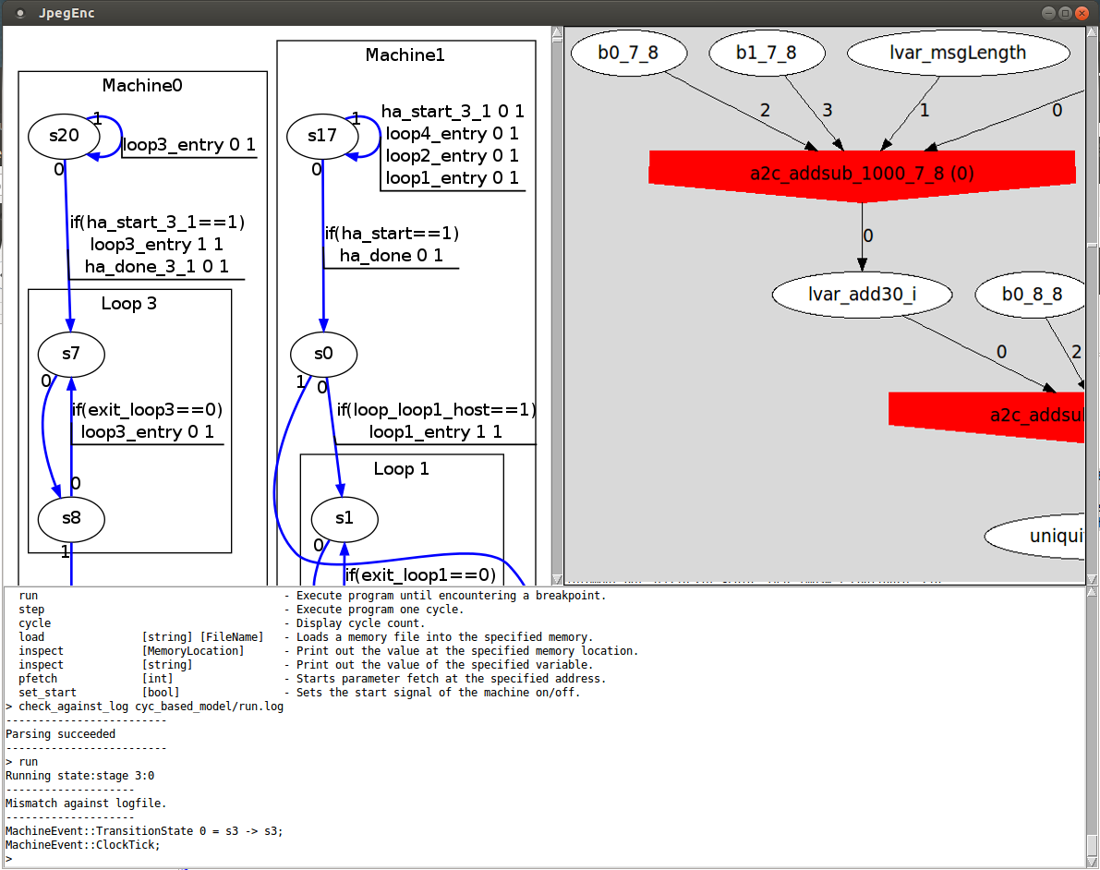
CDFG Simulator
Mouse identifying varible underneath
Click create a pull-down menu
Trace – Waveform Window if possible
Inspect – Simulator Tcl Command
Driver – Generate the Driver Cone
Trace
Inspect
Driver
start
step
cycle
run

Slide 10
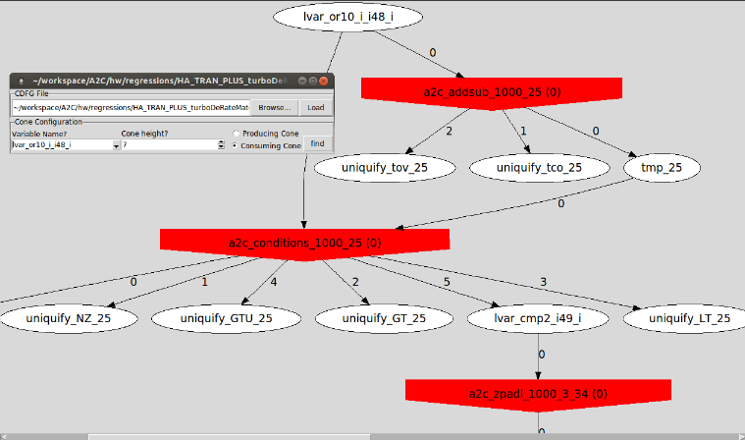
CDFG Tools – Driver Trace

Slide 11
CDFG Tools Logic Modification
Operators
Target
Search
+
op
op
Replace
*
&
op
Replace
All
-
>>
Clear
&
Load
Replacement
|
|
Save
^
op
op
op
bext
bext
bconat
op
Number of matches and other information can be displayed here

Slide 12
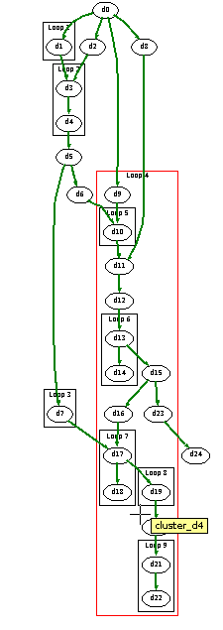
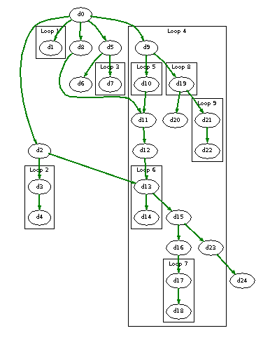
CDFG – Hierarchical Parallel State Machines
Data Dependency
Memory Dependency
State Machine Clusters
c0
s0
c1
s1
s2
s5
s5
c2
s8
s3
s6
s5
s6
s9
s4
s7
s6
s7
s10
s7
Memory
Dependency
Exception
Pair of strings of states
Cluster
List of strings of states
Load
Save
Commit

Slide 13
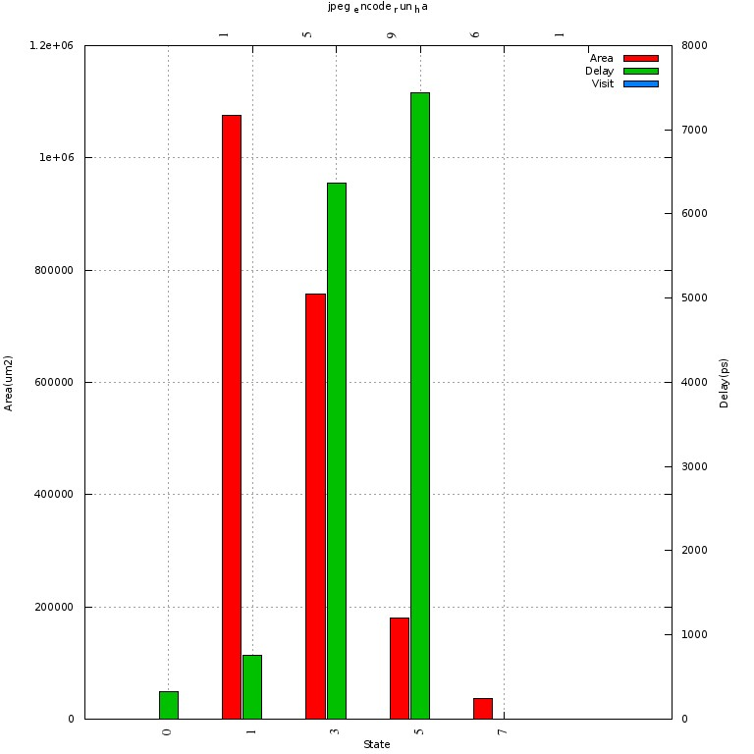
Delay/Area/Power per State with State Visits
Simply paste the <top_functional_name>_cps.jpg from the run directory to here.

Slide 14
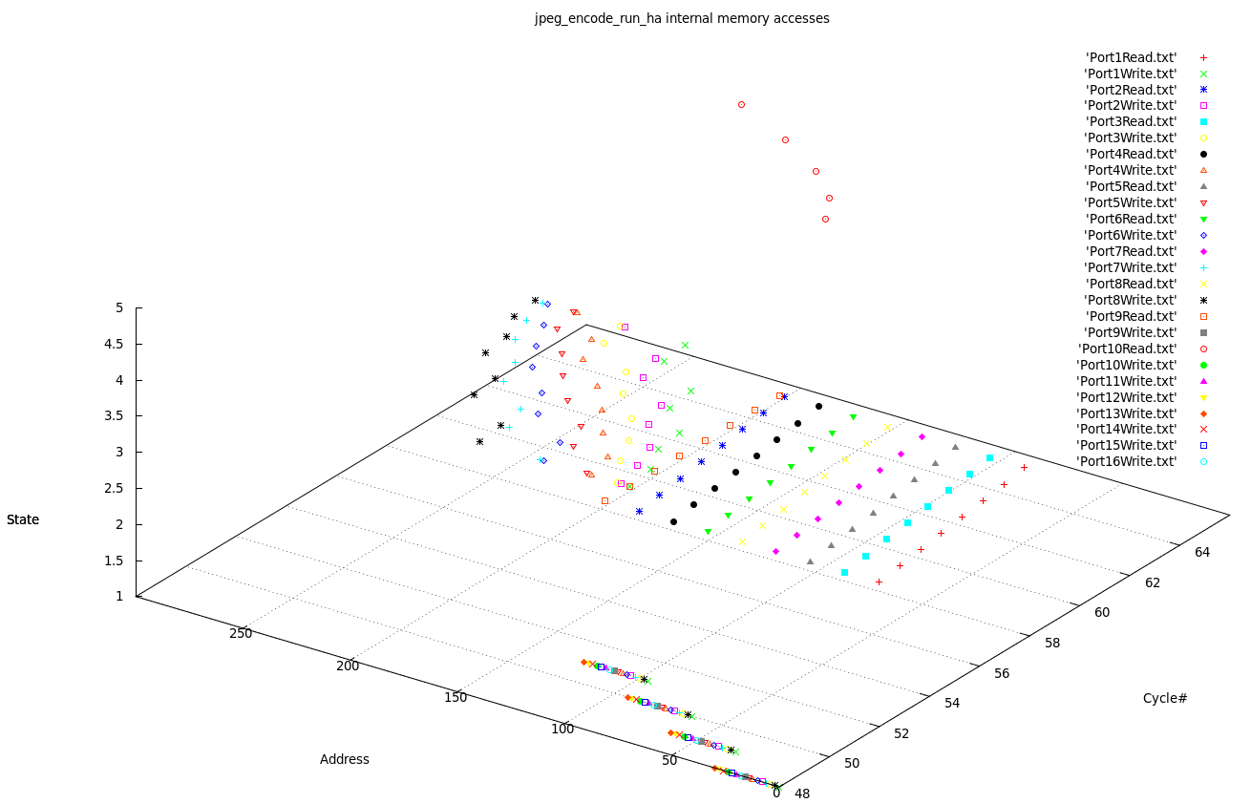
Memory Accesses Trace
This is a plot from gnuplot. Ideally, after each “Synthesis”, there should be a file called int_access.plt in cyc_based_model/data. Start gnuplot inside the GUI, load “int_access.plt”
The resulting plot should remain to be interactive. It means that users can rotate/zoom it.

Slide 15
Hierarchical C Code Analysis
SM0
#LLVM ops
SM0
F0
F1
F2
F3
F4
F2
F5
F4
#LLVM ops
F0
F1
F2
F3
F4
F2
F5
F4
SM1
#LLVM ops
F1
F2
F3
F4
F2
F5
F4
#LLVM ops
F1
F2
F3
F4
F2
F5
F4
Candidates
F3 A(F3)
F1 A(F1)
F4 A(F4)
F5 A(F5)
F2 A(F2)
Add
Add

